Slide 1
Unsupervised Machine Learning for Anomaly Detection using an Autoencoder
Marvin Arnold
Faculty of Computer Science
Profilprojekt Anwendungsforschung in der Informatik
xx.03.2020

Slide 2
Agenda
Motivation - Anomaly Detection
Available Data
Task
Classical Approaches
Autocorrelation
Mean Absolute Change
Machine Learning Approach
Autoencoder Concept
Architecture
Results
Qualitatively
Quantitively
Latent Spaces
Reduced Model
Conclusion, Outlook and Problems

Slide 3
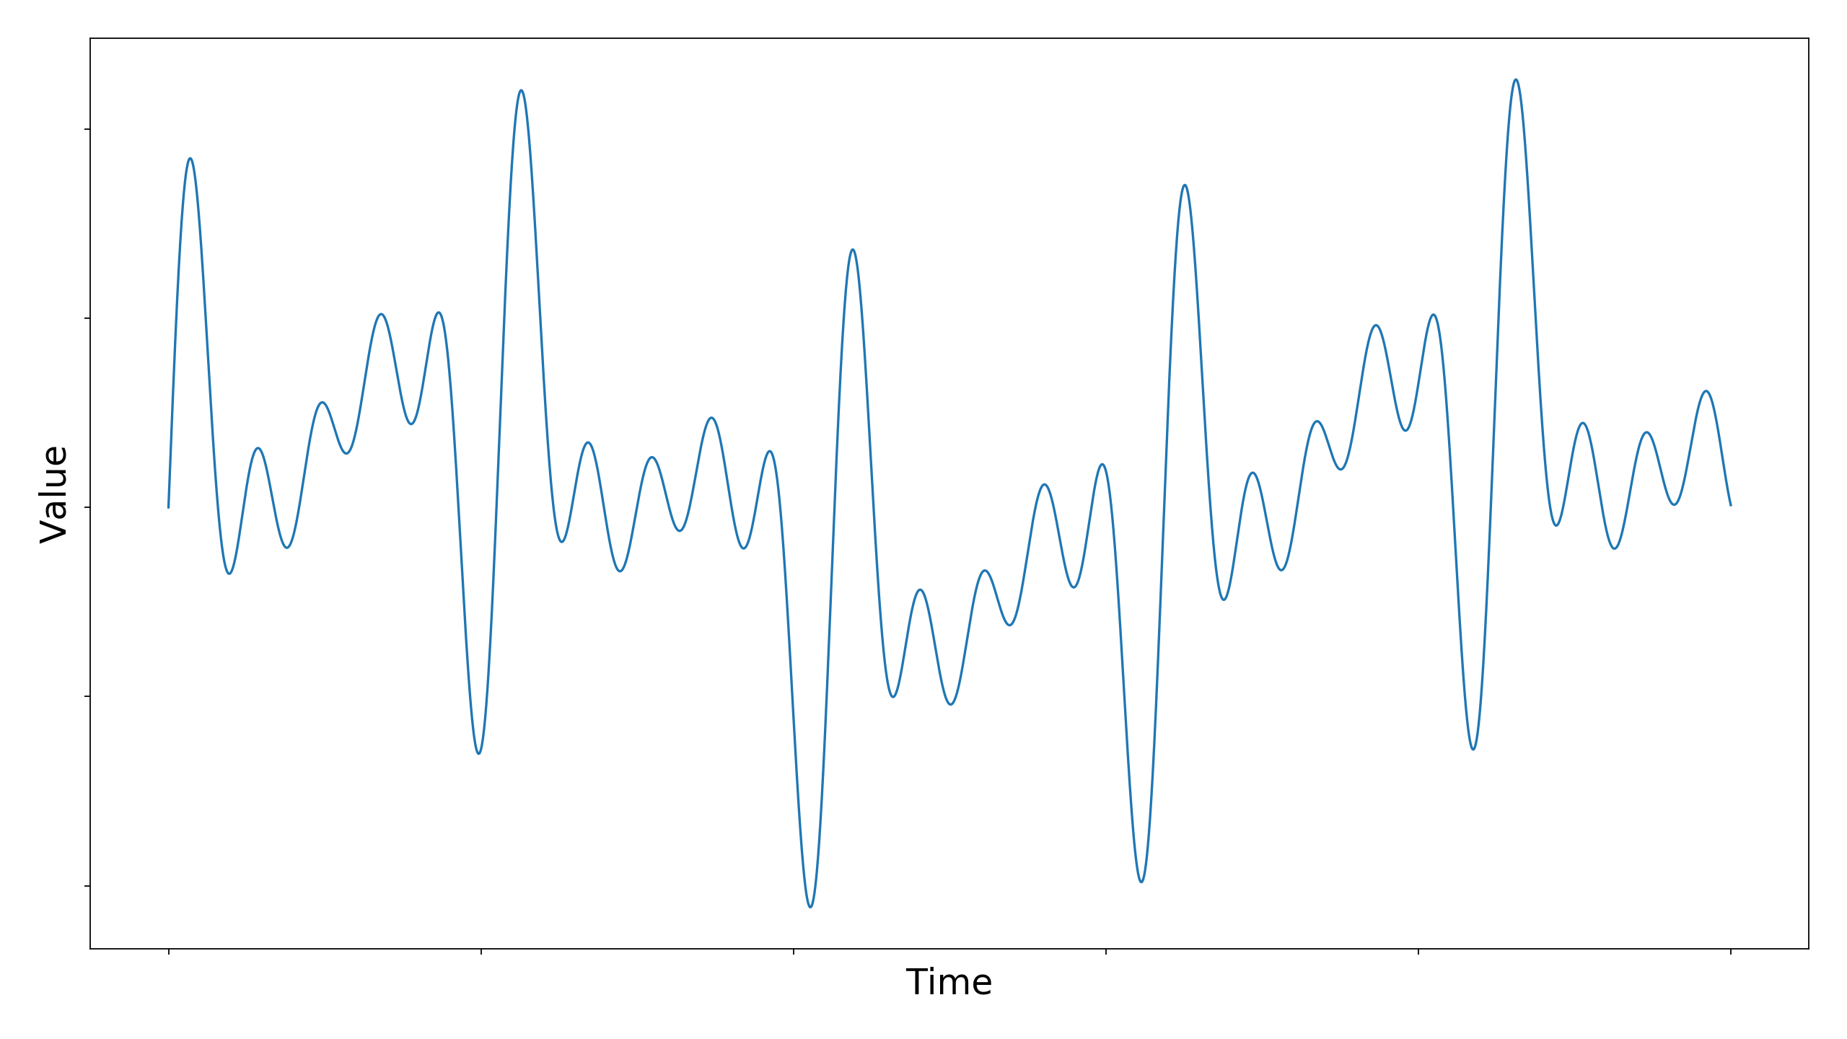
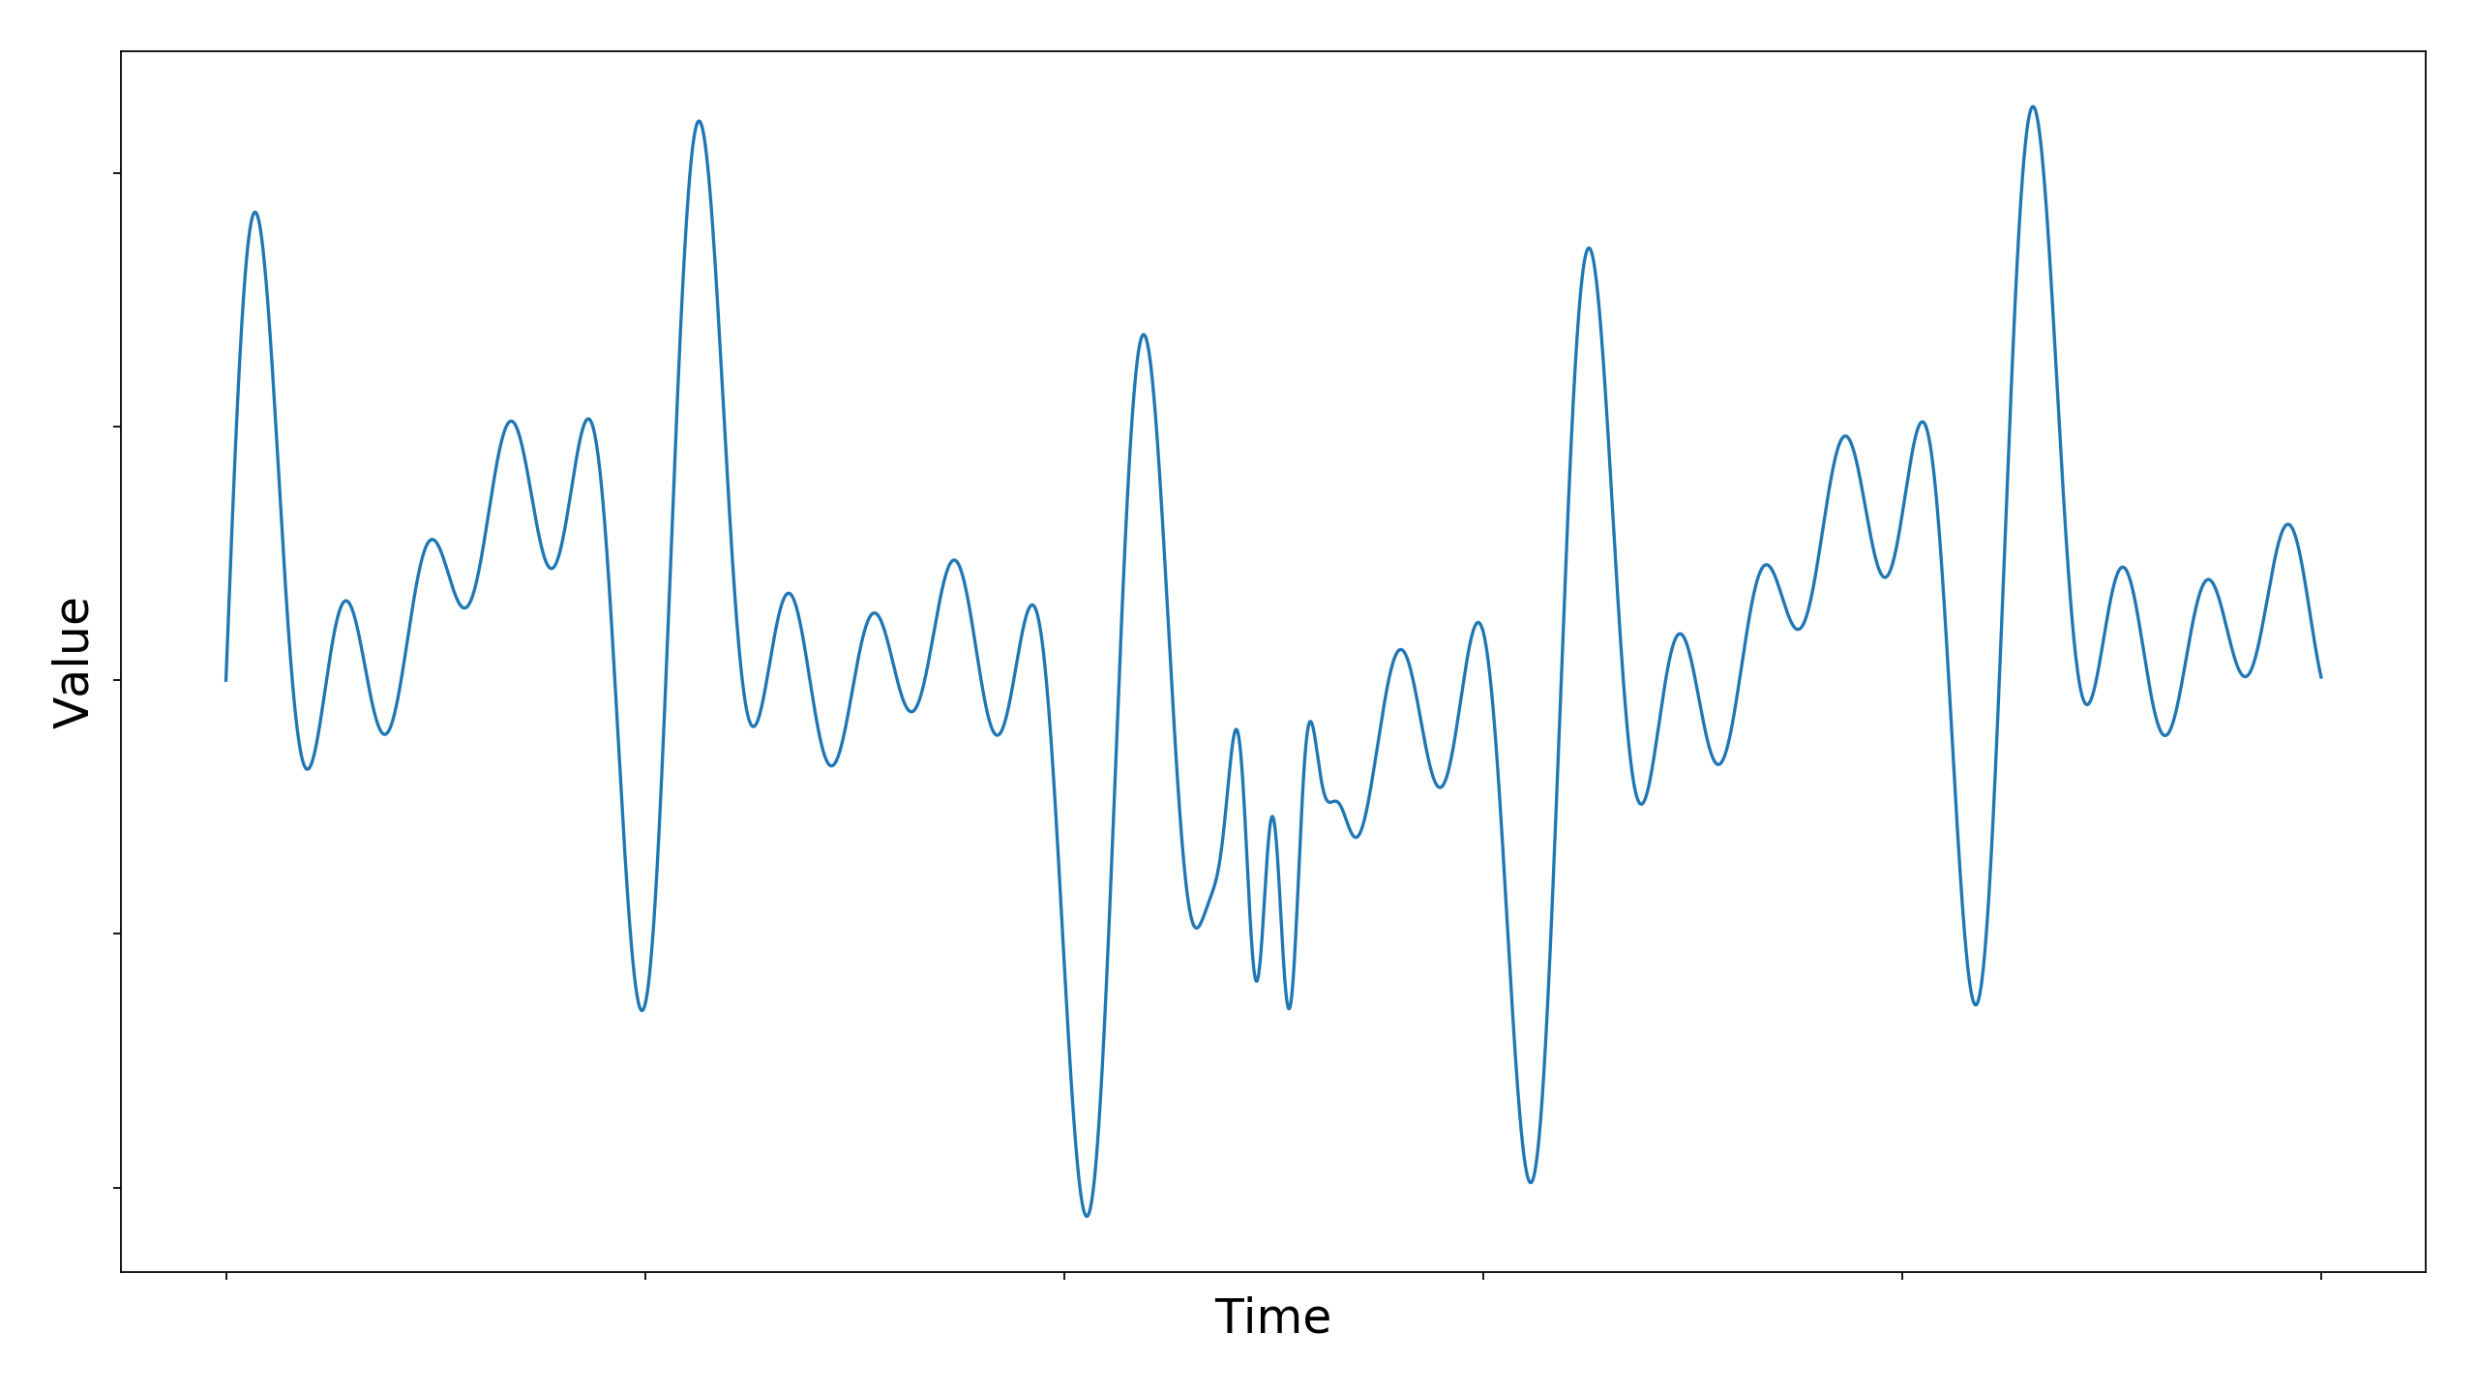
Motivation - Anomaly Detection
Detect abnormal behaviour/patterns of measurements of a machine
Catch: It is unknown how the anomaly manifests itself in the measurement data (think nuclear power plant)
Normal behaviour
Possible error behaviour
Previously unknown behaviour. Is this an error or just noise/measurement error?

Slide 4
Available Data
Bearings running until they break → 2 datasets available (”Lager 4” and “Lager 5”)
Every 2 minutes 4 separate measurements from 4 ultrasonic sensors
Available “ground truth” data: Raw signal, amplitude spectrum, spectrogram, envelope spectrum
Expert Feature: Specific area in envelope spectrum that shows more noise as bearing is breaking
Knowledge of expert feature is very problem specific
Envelope spectrum (good)
Envelope spectrum (start of failure)

Slide 5
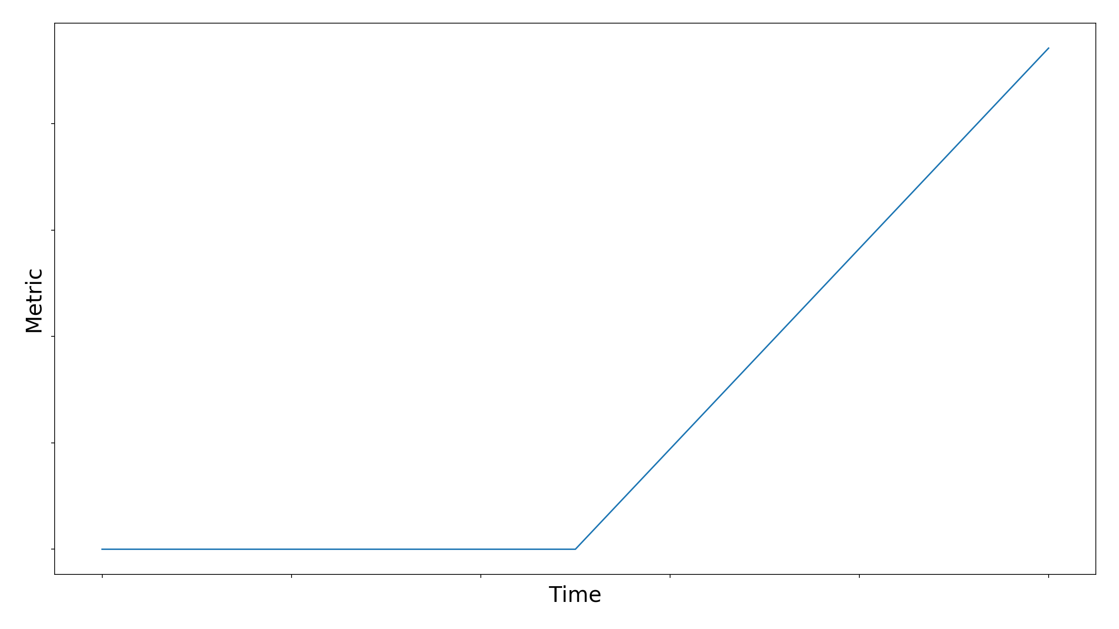
Task
Raw audio bearing should contain all the necessary information to detect the starting point of the degradation.
Use an appropriate machine learning scheme to map non pre-processed audio recording to an error plot.
Main Idea:
Use a metric that increases when bearing degrades → Change point visible
Unsupervised approach possible without knowing labels beforehand
Reduction of expert feature possibilities to universal metric plot
Evaluation using ROC and AUC
Degradation Metric
Low Metric

Slide 6
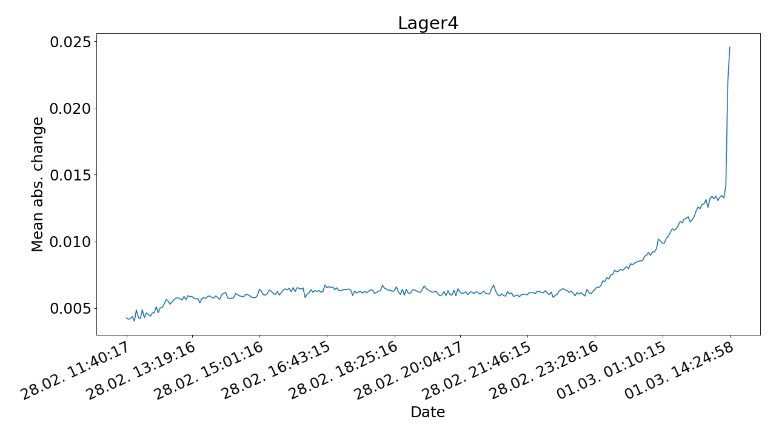
Classical Approaches (non machine learning)
We calculate 65 classical statistical features and search for a separability threshold
This includes: autocorrelation, kurtosis, linear trend, mean, median, skewness, variance, …
Mean absolute change:
Describes the absolute change between two consecutive measurement points
Error = Mean abs. change
Error curve looks nearly ideal
Change point almost perfectly hits the expert opinion
AUC = 0.99
Change point

Slide 7
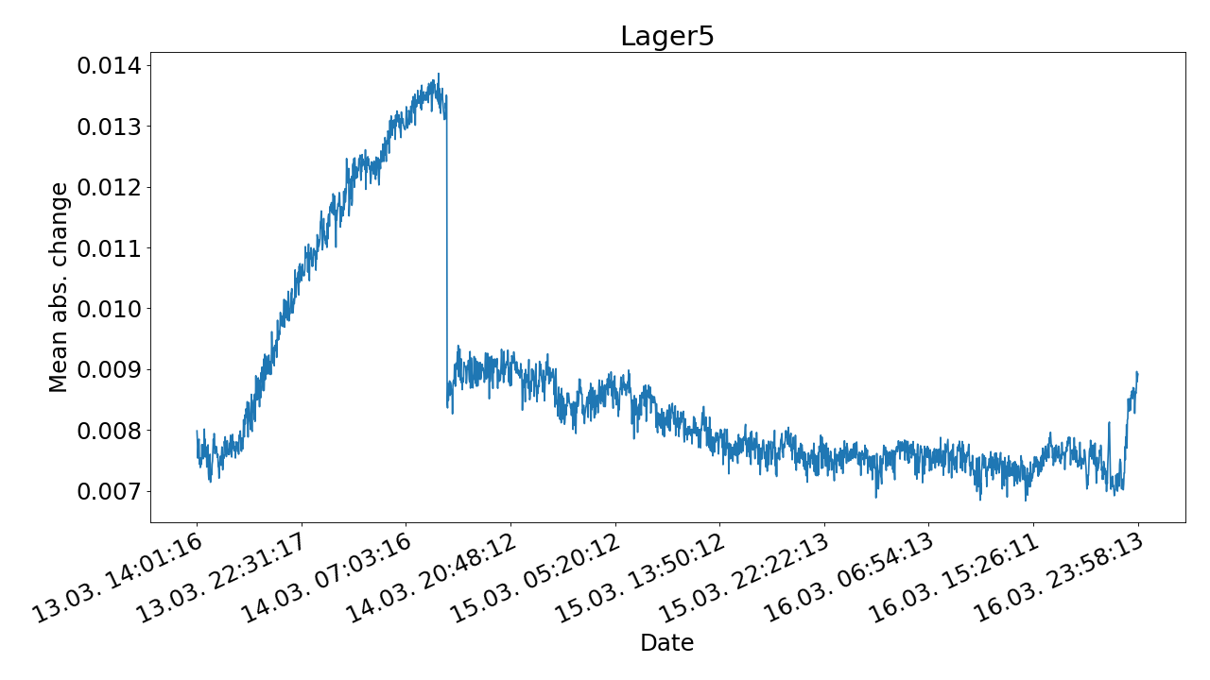
Problems with mean absolute change
Lager 5 does not look so nice …
Error seems to happen right at the start
Afterwards big drop in error
Error after change point is not increasing
AUC = 0.21 (classifier could be reversed)
→ Does not work universally
Expert
change point

Slide 8
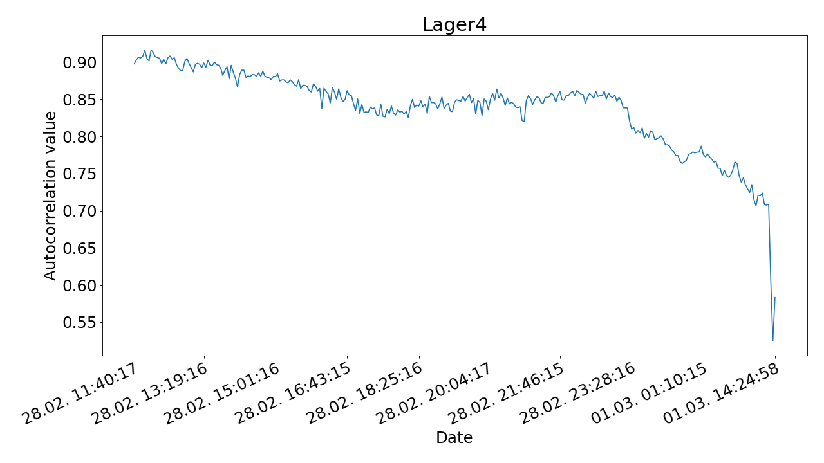
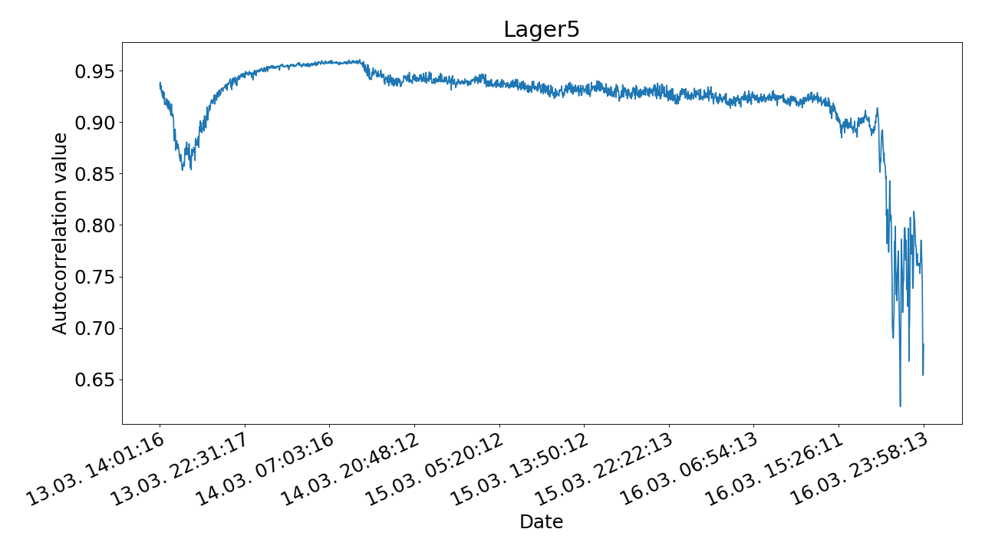

Autocorrelation
As bearing rotates one full revolution measurement values should correlate with previous revolution
Using the microphones sampling frequency → 6144 Measurement samples $⟷$ one revolution
Lager 4 AUC = 1.00
Lager 5 AUC = 0.98

Slide 9
Problems with autocorrelation
We need to specify the autocorrelation lag → we know the exact lag of 6144 thus the results are very good
What if we don’t know the “correct” lag?
AUC values for different lags
 | 128 | 256 | 512 | 1024 | 2048 | 4096 | 8192 | 16384
Lager 4 | 0.94 | 0.78 | 0.81 | 0.84 | 0.59 | 0.76 | 0.57 | 0.60
Lager 5 | 0.98 | 0.89 | 0.95 | 0.69 | 0.93 | 0.92 | 0.94 | 0.86
Guessing the lag gets us random good and bad results
→ We require knowledge of the underlying problem to find optimal lag value

Slide 10

Machine Learning Approach - Autoencoder
Reconstruction of the $[0, 1]$ normalized original signal
We expect the reconstruction of a healthy signal to be better than on a signal showing degradation
Evaluation metric: Sum of the quadratic error of each time step in each measurement
Good reconstruction
Bad reconstruction
Degradation
happens

Slide 11


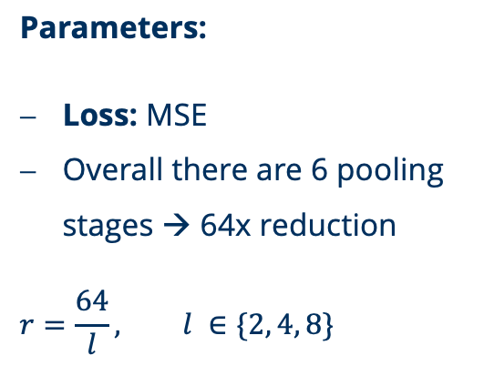


Autoencoder Architecture
Reconstructed input
Input
Latent space
Legend:
1D Convolution
1D Max pooling (2x)
1D Upsampling (2x)
Window size
…
…
Parameters:
Loss: MSE
Overall there are 6 pooling stages → 64x reduction
$$r=\frac{64}{l}, l ∈\{2, 4, 8\}$$
1
$$r$$
$$r$$
$$r$$
$$r$$
$$r$$
1

Slide 12
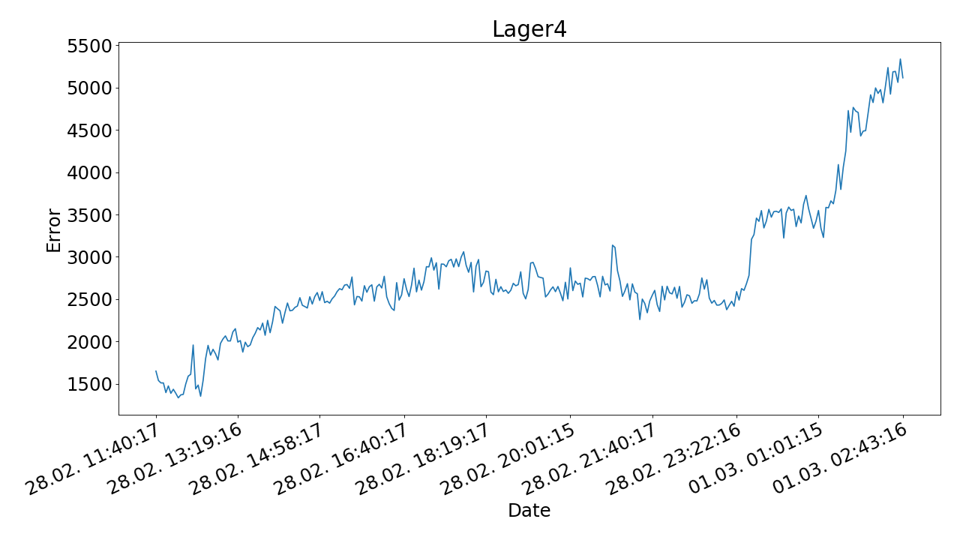
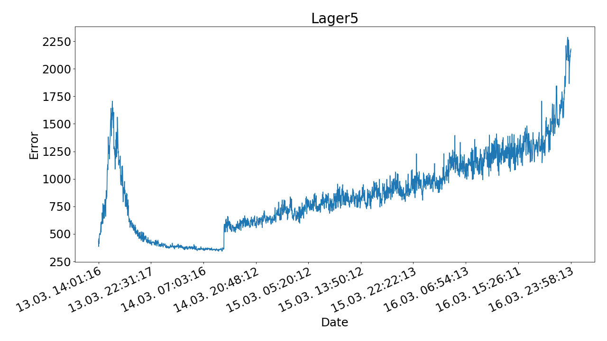
Autoencoder Results - Qualitatively
Window size: 128; Latent space size: 50%
Behaviour of error is as expected: As bearing degrades error goes up (Lager 5 has longer warm-up time)
Error functions shows signs of steps → indication of different error states
Error curve is rather smooth thus making finding a threshold easier
But: This plot is only for window size = 128. How do other window sizes behave?

Slide 13
Autoencoder Results - Quantitatively
Lager 4: AUC depending on window sizes and latent space size
 | 128 | 256 | 512 | 1024 | 2048 | 4096 | 6144 | 8192
50% | 0.98 | 0.83 | 0.64 | 0.72 | 0.75 | 0.80 | 0.77 | 0.79
25% | 0.82 | 0.59 | 0.47 | 0.57 | 0.62 | 0.75 | 0.73 | 0.77
12,5% | 0.57 | 0.51 | 0.45 | 0.50 | 0.03 ? | 0.67 | 0.64 | 0.69
Lager 5: AUC depending on window sizes and latent space size
 | 128 | 256 | 512 | 1024 | 2048 | 4096 | 6144 | 8192
50% | 0.97 | 0.92 | 0.91 | 0.82 | 0.87 | 0.70 | xxx | 0.77
25% | 0.94 | 0.87 | 0.91 | 0.93 | 0.82 | 0.84 | xxx | 0.75
12,5% | 0.91 | 0.96 | 0.72 | 0.88 | 0.93 | 0.84 | 0.73 | 0.70
AUC performance seems to correlate with window size
Network Lager 4, window size 4096, latent space 12,5%: learned the inverse of the expected behaviour

Slide 14
Autoencoder Results - Latent Spaces
From previous experiments we expect a clustering of latent spaces when applying PCA or TSNE
We plot latent spaces transformed by PCA into 2D as the bearing runs (from early = red to late = blue)
TSNE did not yield any useful clustering results
Lager 4; WS 128; Lat. 50%
Lager 4; WS 1024; Lat. 50%
Lager 4; WS 4096; Lat. 50%
Clustering is better the bigger the window size is → inverse correlation with AUC results

Slide 15
Autoencoder - Reduced Model
Window size 128 yielded the best results → reduce the window size further to check if this trend continuous
Reducing the model to 3 down sampling steps to make window size 8 possible
Lager 4: AUC depending on window sizes and latent space size
 | 8 | 16 | 32 | 64
50% | 1.0 | 0.99 | 0.98 | 0.98
Although the window size is very small the network behaves as expected
The error noise caused by the degradation introduces high frequency components into the signal
These components thus also influence very small window sizes

Slide 16
Conclusion, Outlook and Problems
Degradation starting point can be determined by an expert exactly knowing which feature to look at
Finding a classical generally applicable feature is very hard
The application of an autoencoder machine learning model reduces the feature space to 1 error plot
Some fine tuning parameters remain e.g. the window size making the model not always universal
We only evaluate the separability of the resulting error plot
No instructions yet on how to find a good threshold
Sometimes the network is better in reconstructing erroneous data (reversed classifier) than ”normal” data
Inverse correlation of latent space clustering and performance

